Slide 1
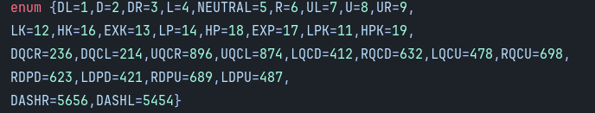

Slide 2












Slide 3
Managing inputs

Slide 4
Prerequisite
1. you know what a fighting game is
2. you may have an interest in coding a fighting game
3. you have an input system (this video is managing not capturing this data)

Slide 5
Each input one at a time shown when i speak
N

Slide 6
N

Slide 7
N

Slide 8
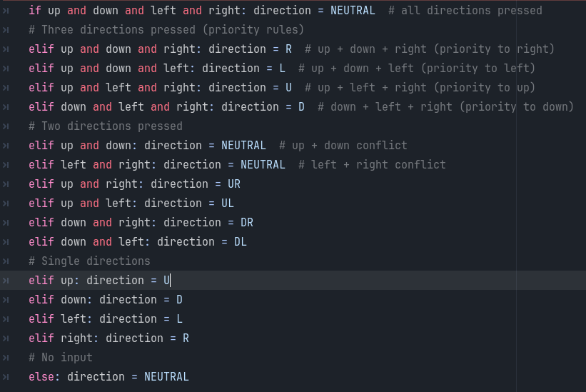
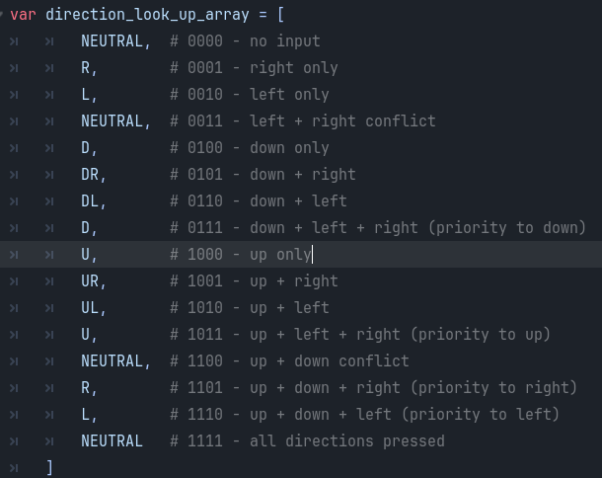
To do this in code

Slide 9
7 8 9
4 5 6
1 2 3
UL U UR
L N R
DL D DR
N

Slide 10
Types of blocking
Images of sf6(regular and parry),smash bros

Slide 11
How blocking works

Slide 12
To do this in code

Slide 13
The subjective Projectile case

Slide 14
To do this in game engine

Slide 15
How to make an input manger for fighting games

Slide 17
Each input one at a time shown when i speak
N

Slide 18
Add images V
Some attack
DQCF+LP
Some other attack
FDPD+LP
Some other other attack
DQCB e+HK

Slide 19
A scanner of the inputs showing when a code is valid slowly
oldest
N
N
N
N
N
N
N
Newest

Slide 20
A scanner of the inputs showing when a code is valid slowly and this time with gaps
oldest
N
N
N
Newest

